Slide 1
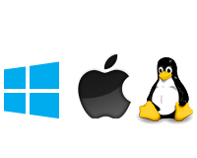
INTRODUCTION TO ASP.NET CORE

Slide 2
What is .net core?
ASP.NET Core is a redesign of ASP.NET, with architectural changes that result in leaner and modular framework.
.Net Core is open-source.
Cross platform.
Authentically .Net.
Supports .Net Standard Library(NSL).

Slide 3
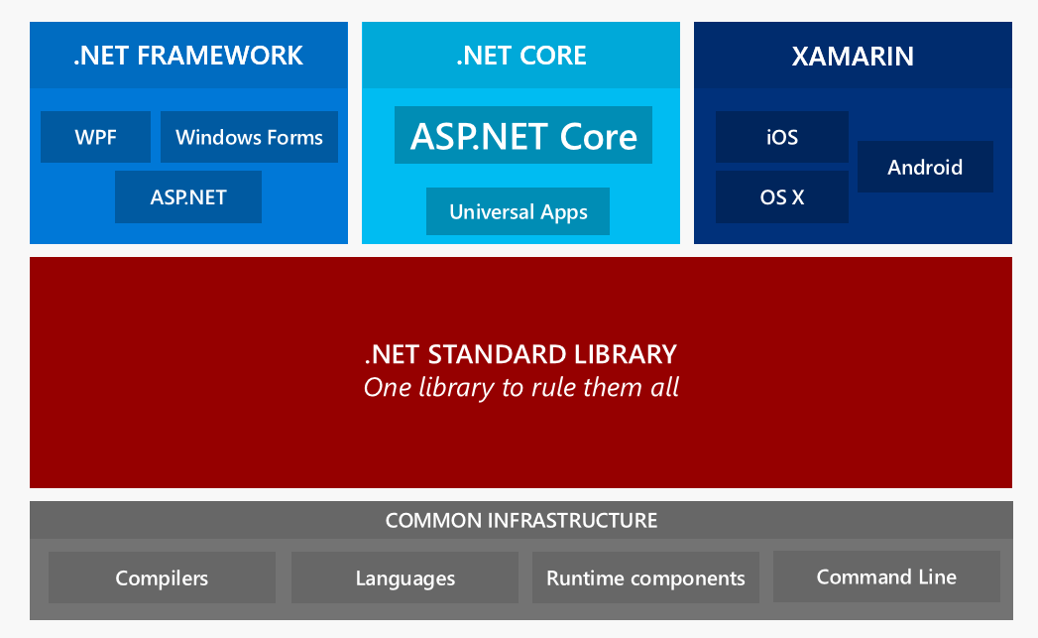

Slide 4
.Net standard library
The .NET Standard Library meta package describes the set of libraries that define one or more .NET Standard versions.
.Net Standard Library is human curated .
All platforms strive to be of the level of Standard Library but the Standard Library keeps on increasing its versions by inheriting from its previous versions.

Slide 5
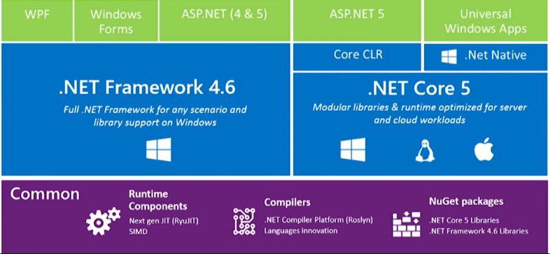
Relationship between .NET Core & .NET Framework

Slide 6
Main Features of . Net Core
Cross-platform needs.
Micro Services architecture.
Docker containers.
High-performance and scalable systems.
Side by side .NET versions per application.

Slide 7
Cross-platform needs.
If your application (web/service) needs to run on multiple platforms (Windows, Linux, and macOS), use .NET Core.
.NET Core supports the previously mentioned operating systems as your development workstation. Visual Studio provides an Integrated Development Environment (IDE) for Windows and Mac. You can also use Visual Studio Code, which runs on macOS, Linux, and Windows. Visual Studio Code supports .NET Core, including IntelliSense and debugging.

Slide 8
MicroServices architecture
A microservices architecture allows a mix of technologies across a service boundary . For example, you can mix microservices or services developed with .NET Framework, Java, Ruby, or other monolithic technologies.
There are many infrastructure platforms available. Azure Service Fabric is designed for large and complex microservice systems. Azure App Service is a good choice for stateless microservices.

Slide 9
Docker containers
Containers are commonly used in conjunction with a microservices architecture.
Containers can also be used to containerize web apps or services that follow any architectural pattern.
.NET Framework can be used on Windows containers, but the modularity and lightweight nature of .NET Core makes it a better choice for containers.

Slide 10
High-performance and Scalable Systems
When your system needs the best possible performance and scalability, .NET Core and ASP.NET Core are your best options. High-performance server runtime for Windows Server and Linux makes .NET a top performing web framework on TechEmpower benchmarks.

Slide 11
Side by side of .NET versions per application level
.NET Core offers side-by-side installation of different versions of the .NET Core runtime on the same machine. This side-by-side installation allows multiple services on the same server, each of them on its own version of .NET Core. It also lowers risks and saves money in application upgrades and IT operations.

Slide 12
Other Features
A unified story for building web UI and web APIs.
Integration of modern client-side frameworks and development workflows.

Slide 13
Common language runtime
The .NET Core Framework provides a run-time environment called the common language runtime , which runs the code and provides services that make the development process easier.

Slide 14
Common language runtime
Compilers and tools expose the common language runtime's functionality and enable you to write code that benefits from this managed execution environment.
Code that you develop with a language compiler that targets the runtime is called managed code; it benefits from features such as cross-language integration, cross-language exception handling, enhanced security, versioning and deployment support, a simplified model for component interaction, and debugging and profiling services.

Slide 15
Common language runtime
The common language runtime makes it easy to design components and applications whose objects interact across languages. Objects written in different languages can communicate with each other, and their behaviors can be tightly integrated.
This cross-language integration is possible because language compilers and tools that target the runtime use a common type system defined by the runtime, and they follow the runtime's rules for defining new types, as well as for creating, using, persisting, and binding to types.

Slide 16
Performance improvements of clr
The ability to easily use components developed in other languages.
Extensible types provided by a class library.
Language features such as inheritance, interfaces, and overloading for object-oriented programming.
Support for structured exception handling.
Garbage collection.
Use of delegates instead of function pointers for increased type safety and security. For more information about delegates.

Slide 17
What is DOTNET Native?
.NET Native is a native tool chain which is a pre-compilation technology for building and deploying Windows apps.
It automatically compiles the release version of apps that are written in managed code (C# or Visual Basic) and that target the .NET Framework to native code.

Slide 18
How .NET Native Works
Typically: apps that target the .NET Framework are compiled to intermediate language (IL). At run time, the just-in-time (JIT) compiler translates the IL to native code.
.NET Native compiles Windows apps directly to native code

Slide 19
.NET NATIVE AND COMPILATION
How .NET Native is different from other compilers targeting .NET Core framework

Slide 20
The not .NET Native Compilers!
Metadata
Implementation Code
.NET Framework Class Libraries and Additional Class Libraries
The Common Language Runtime

Slide 21
The .NET Native !!
For certain code paths, it replaces code that relies on reflection and metadata with static native code.
Where possible, it attempts to eliminate all metadata.
It includes in the final app assemblies only the implementation code that is actually invoked by the app.
It replaces the full CLR with a refactored runtime that primarily contains the garbage collector.

Slide 22
Advantages:
Fast execution times.
Consistently speedy startup times.
Optimized app memory usage.

Slide 23
.Net Native != Just a Complier
During pre-compilation, required portions of the .NET Framework are statically linked into your program.
The .NET Native runtime is optimized for static pre-compilation and thus is able to offer superior performance.

Slide 24
CORE-RT vs CORE-CLR
Both .NET Native and Core CLR uses Ryu JIT Compiler (by default).
The difference is .NET Native uses it as an Ahead-of-Time (AOT) compiler where CORE-CLR uses it as a Just-in-Time Compiler(JIT).
Core RT is the .NET Core runtime that is optimized for AOT scenarios, which .NET Native targets.
Core RT is a layered architecture whose base is a small execution engine that provides services such as garbage collection.

Slide 25
What is asp.net core mvc framework ?
The ASP.NET Core MVC framework is a lightweight, open source, highly testable presentation framework optimized for use with ASP.NET Core.
ASP.NET Core MVC provides a patterns-based way to build dynamic websites that enables a clean separation of concerns.
Advantages of MVC: Helps to keep the program organized from start to end and also structures the project.

Slide 26
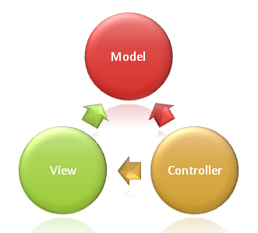
.net core mvc framework
What is the MVC pattern?
The Model-View-Controller(MVC) architecture
pattern separates an application into three
main groups of components: MODELS,VIEWS
and CONTROLLERS
The Controller chooses the view to display to
the user ,and provides it with any Model data
that is required.
Note: Both the view and the controller depend on the model. However, the model depends on neither the view nor the controller.(Beneficiary , Easily Testable)

Slide 27
What do the terms model , view and controller mean?
Model : The Model in an MVC application represents the state of the application and any business logic or operations that should be performed by it. Business logic should be encapsulated in the model, along with any implementation logic for persisting the state of the application.
Views: Views are responsible for presenting content through the user interface. There should be minimal logic within views, and any logic in them should relate to presenting content.
Controller: Controllers are the components that handle user interaction, work with the model, and ultimately select a view to render . The controller handles and responds to user input and interaction . In layman terms , the controller controls how the app responds to a given request.

Slide 28
Dotnet build
Builds a project and all of its dependencies.
It converts the project code into an IL file with a .dll or .exe extension.
All the files useful for debugging are converted into .pbd files and all the dependency files are converted into .deps.json

Slide 29
Dotnet restore
Building requires the project.assets.json file, which lists all the dependencies of your application.
The file is created when dotnet restore is executed.
With .NET Core 1.x , you needed to explicitily run the dotnet restore before running dotnet build. Starting with .NET Core 2.0 dotnet restore runs implicitily when you run dotnet build

Slide 30
Dotnet publish
If the project has third-party dependencies, such as libraries from NuGet , they aren't available with the project's built output..
Dot net publish compiles the application, reads through its dependencies specified in the project file, and publishes the resulting set of files to a directory.
all the third party dependencies gets copied from the NuGet cache into the output folder.

